Slide 1
ARDUINO BASED
HAND GESTURE
CONTROL
FOR COMPUTER

Slide 2
Welcome!!
ARDUINO BASED HAND GESTURE CONTROL FOR COMPUTER

Slide 3
Introduction
You might have seen Hand Gesture Controlled Robots, where the motion of a robot is controlled by the gestures of the hand. Another interesting project based on a similar principle is an Arduino based Hand Gesture Control of your computer or laptop.
We normally use LED Indicators, Switches, Touch Screens and LCD Displays as a part of HMI devices. Another way to communicate with machines like Robots or Computers is with the help of Hand Gestures.
In this project, we have implemented a simple Arduino based hand gesture control where you can control few functions of your web browser like switching between tabs, scrolling up and down in web pages, shift between tasks (applications), play or pause a video and increase or decrease the volume (in VLC Player) with the help of hand gestures.

Slide 4
Aim and Objective:
Basic aim of the project is to control any computer system without touching it and in reliable way,
i.e. Anyone can easily use it using some of the preinstalled hand gesture commands.
It is possible to customize this as per user’s requirement and needs.

Slide 5
Hardware requirements
ARDUINO UNO board
Ultrasonic Sensor
Internet connection(to install libraries)
Working computer/laptop

Slide 6
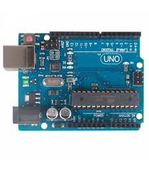
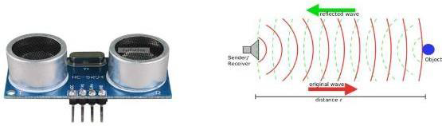
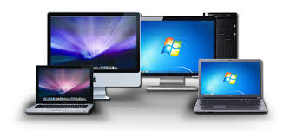

ARDUINO UNO
Ultrasonic Sensor
Computer system
Internet connection

Slide 7
ARDUINO UNO
The Arduino Uno board is based on the ATmega328. Arduino UNO is an Open-Source Platform and easy to understand for beginners. A vital role in Arduino is played by its standard connecters which lets the CPU board connect to various add-on modules known as shields. Motor controls, GPS, Ethernet, LCD, or breadboard are provided by shield. Arduino IDE (integrated development environment) is used to program Arduino boards in C and C++ programming languages over a serial connection.
Ultrasonic Sensor
The ultrasonic sensor is used to determine distance to an object. It emits an ultrasound and this sound travels in the air. When it gets to an object it is reflected back to the ultrasonic sensor .The ultrasonic sensor has four pins, these are: VCC, used to powers the sensor, Trigger, to send the US waves, and Echo, the output pin .The US wave is returned back to sensor through echo pin and GND is connected to the ground pin of Arduino board.

Slide 8
Working of model
ARDUINO BASED HAND GESTURE
It is based on specifying hand position from the ultrasonic sensor.
Via USB connection the microcontroller(used to process raw data) transfers the data value which is provided by the sensor to pc.
Ultrasonic sensor continuously emits sound and it gets reflected back from user’s hand.
The distance between the sounds is send and detection of reflecting back sound wave is calculated by the micro-controller.
Then data is matched with the predefined conditions (gesture resolution) .

Slide 9
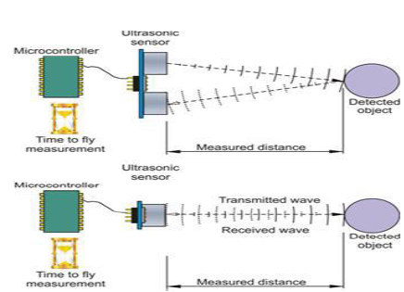
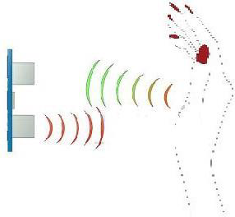

Slide 10
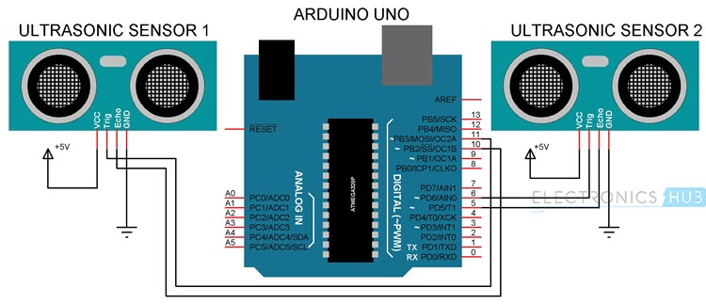
Circuit Diagram
ARDUINO BASED HAND GESTURE CONTROL FOR COMPUTER

Slide 11
Software Requirement
1. Arduino IDE
2. Python 3.8
3. VLC Media Player/Browser

Slide 12
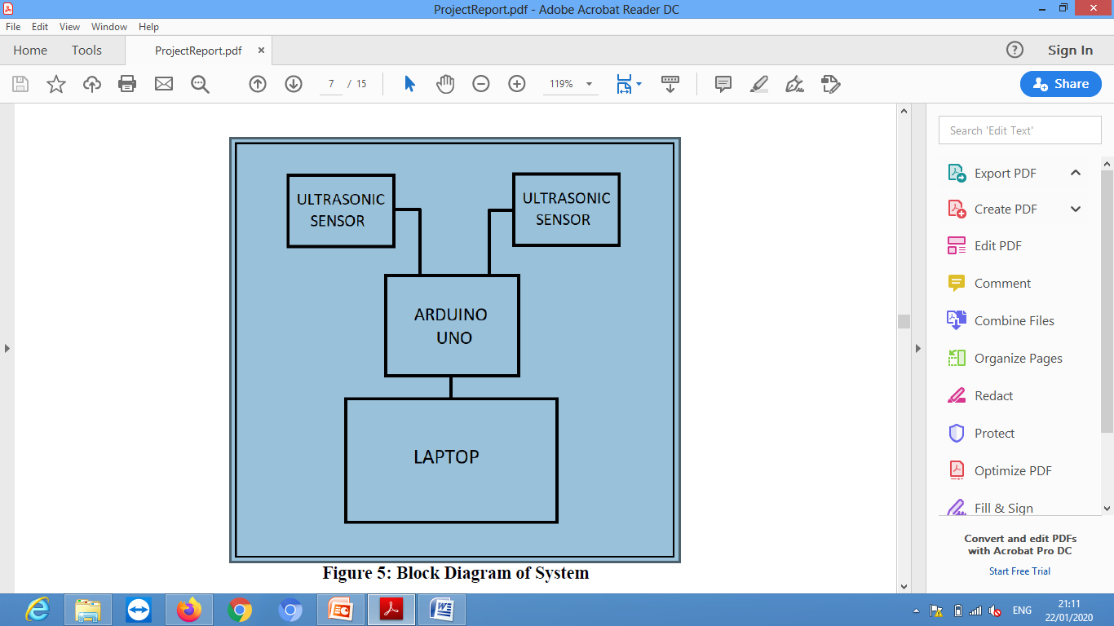
Block Diagram of System
ARDUINO BASED HAND GESTURE

Slide 13
Benefits of the projected System
For this system there is no need of sound to be created so no interruption of background noise.
A number of functions of computer can be operated by using ultrasonic sensor.
This technique may be very useful for those who does not know functionally of computer. This technique decreases the learning time required.
Using this technique it is easy to interact with the computer and there is no language barrier.
By using this system we can control our laptop from a small distance and it can help to control laptop in conference room presentation.

Slide 14
Future Scope
Hand gesture technique is not only limited to gaming, using basic function of computer it can be useful for medical applications. Hand gesture technique can work as input method between medical instruments and human body as proposed.It can be used for operating each and every functions of computer.
Conclusion
This article presents one of the solution among various others, for operating a computer using hand gestures. It is one of the easiest way of interaction between human and computer .It is a cost effective model which is only based on Arduino UNO and ultrasonic sensor. The python IDE allows a seamless integration with Arduino UNO in order to achieve different processing and controlling methods for creating new gesture control solutions.

Slide 15




Refrences:

Slide 16
Thank you
ARDUINO BASED HAND GESTURE CONTROL FOR COMPUTER

